Slide 1
What is the temporal dynamics of CNIH2 local translation
Surbhit Wagle
AG Tchumatchenko

Slide 2
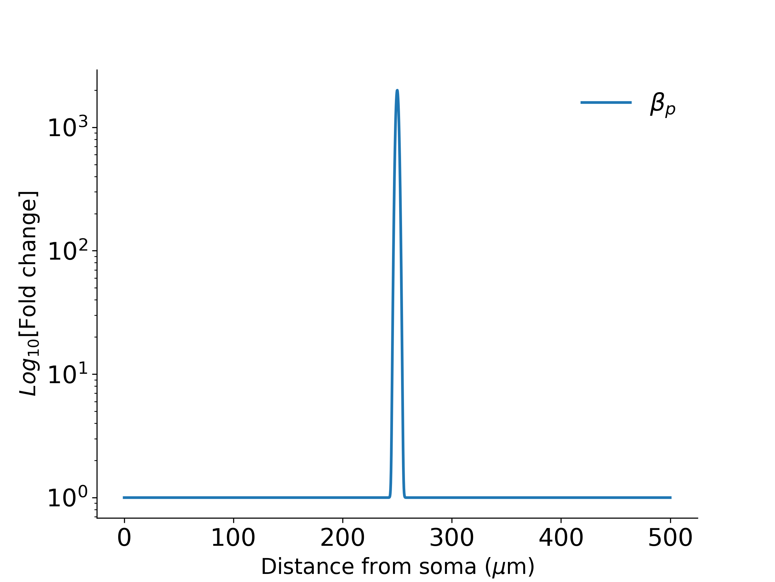
Brief up-regulation of local translation rate (β_{p}), lasts 10 mins
Up-regulated for 10 mins and then set to basal level
From Sun et al 2021 we know that upon glutamate uncagging the porotein ranslation is up-regulated in the local vacinity of the stimulated spines (span ~ 2 𝑢m)
We use this to up-regulate the local trasnaltion rate in our model dendrite at location 250 𝑢m.
By how much is the local translation up-regulated ? (we ramped it up 2000 times)
For how long it says up-regulated? (we kept it up for 10 mins)

Slide 3
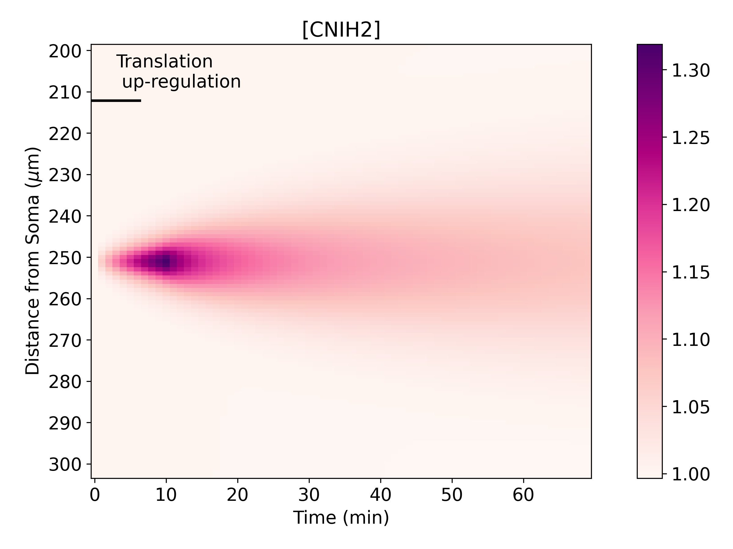
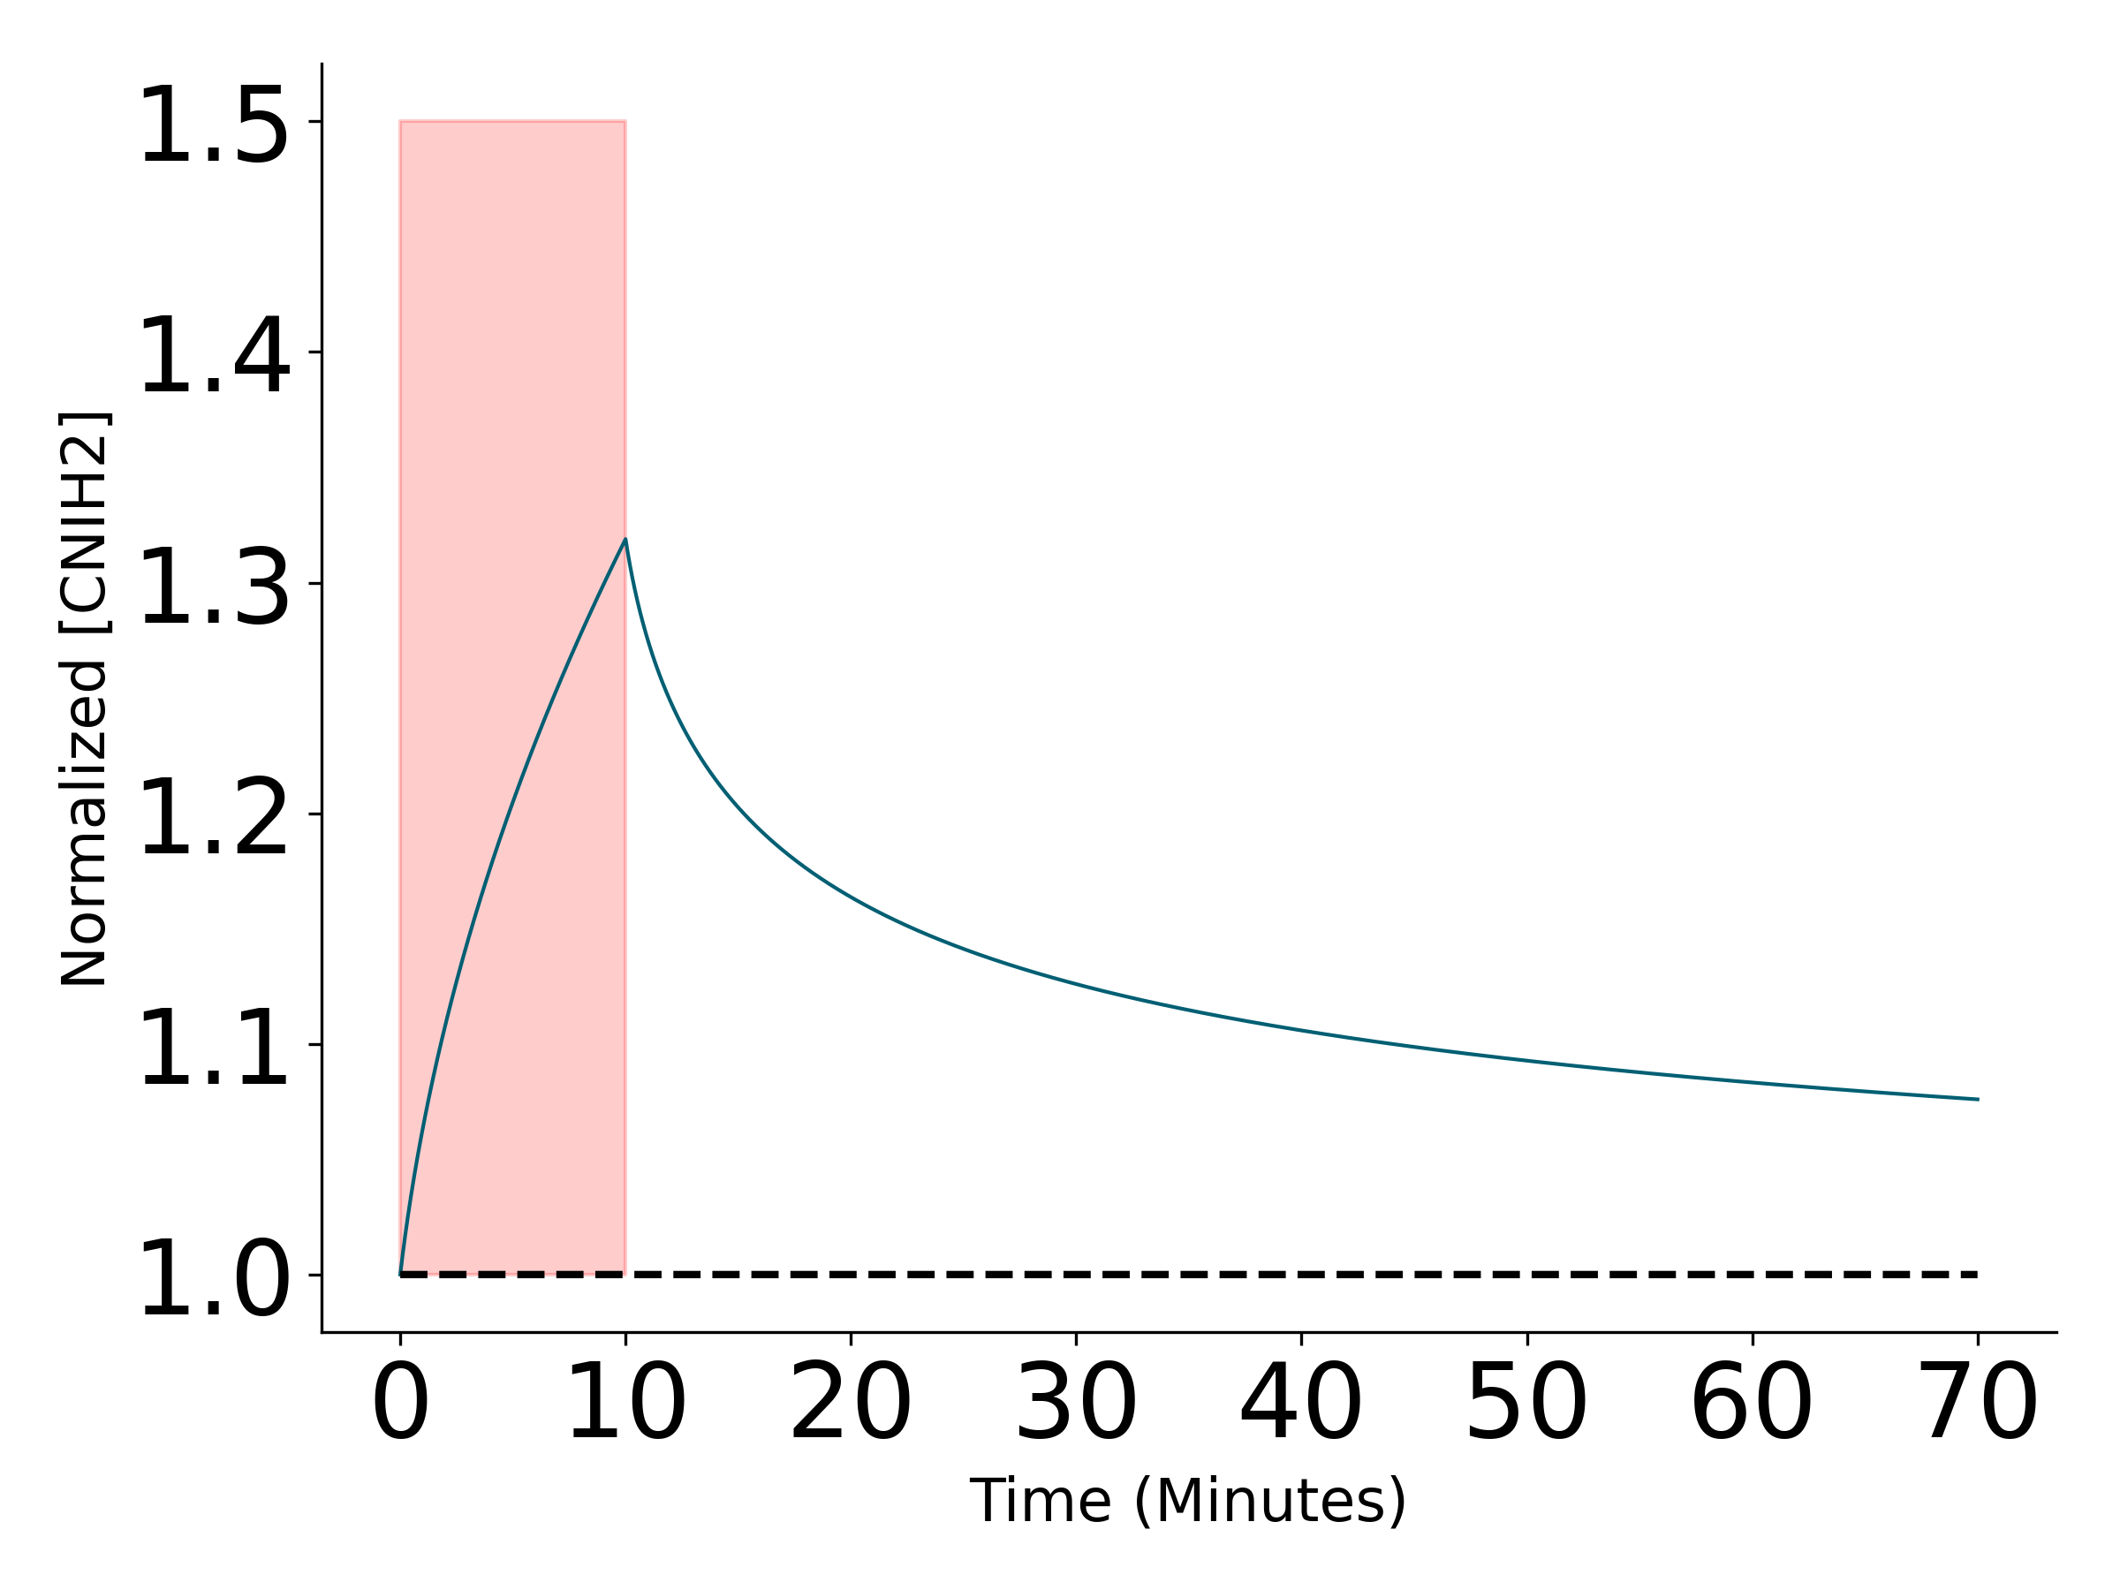
Change in [CNIH2] over time at stimulated and nearby location
At stimulated synapse

Slide 4
Prolonged up-regulation of local translation rate (β_{p}) , lasts 2 hr
Up-regulated for 2 hrs and then set to basal level

Slide 5
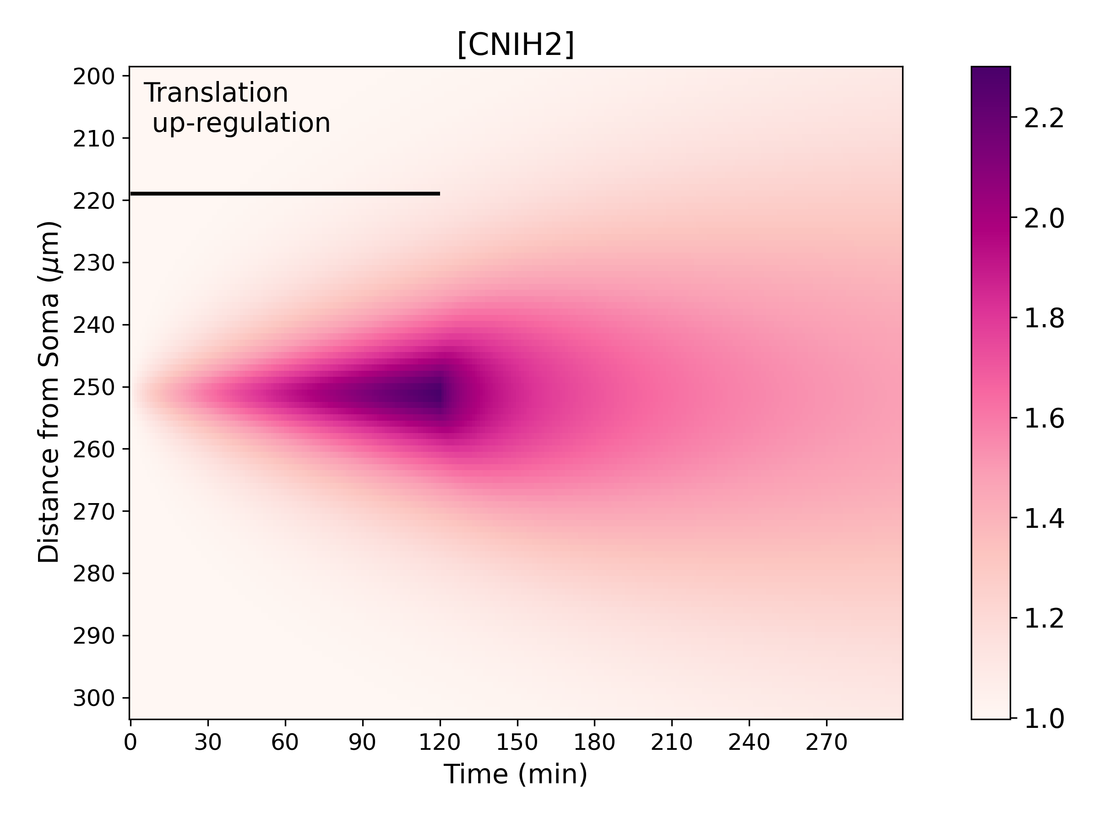
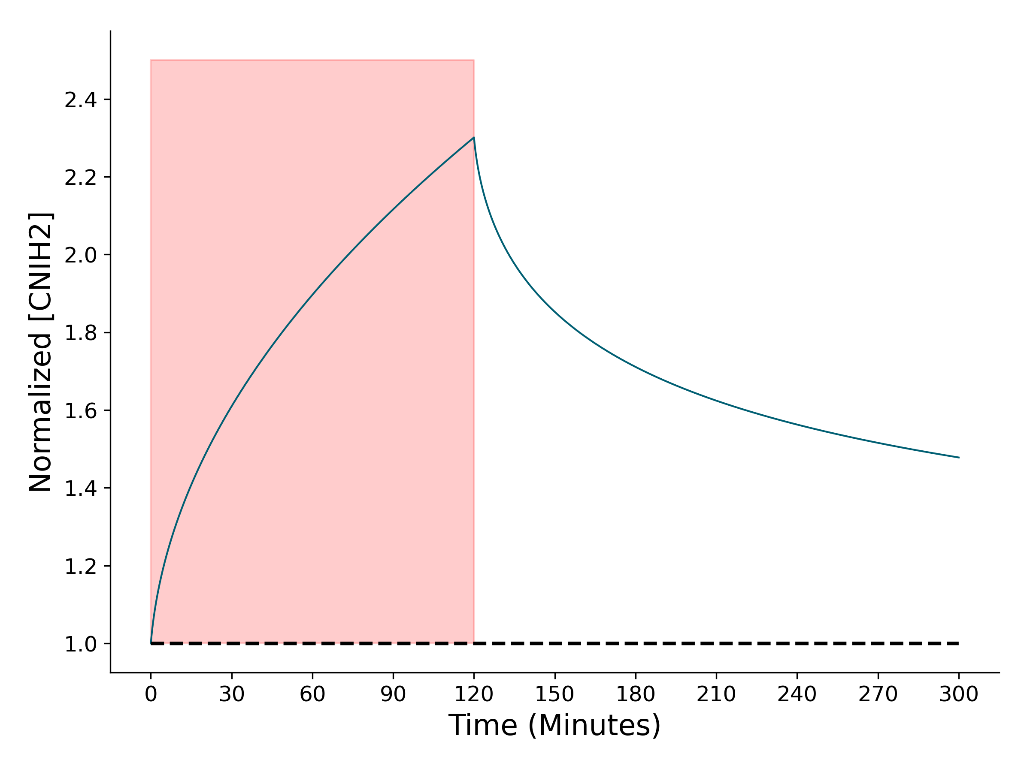
Change in [CNIH2] over time at stimulated and nearby location
At stimulated synapse

Slide 6
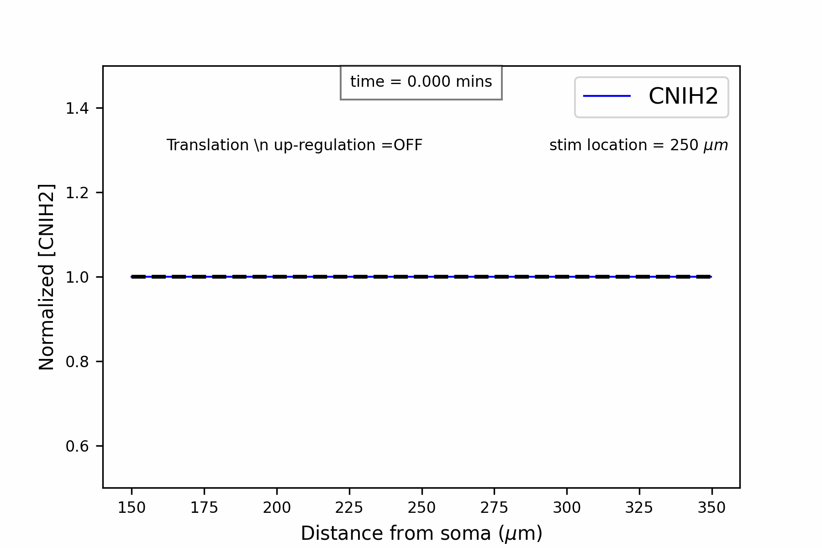
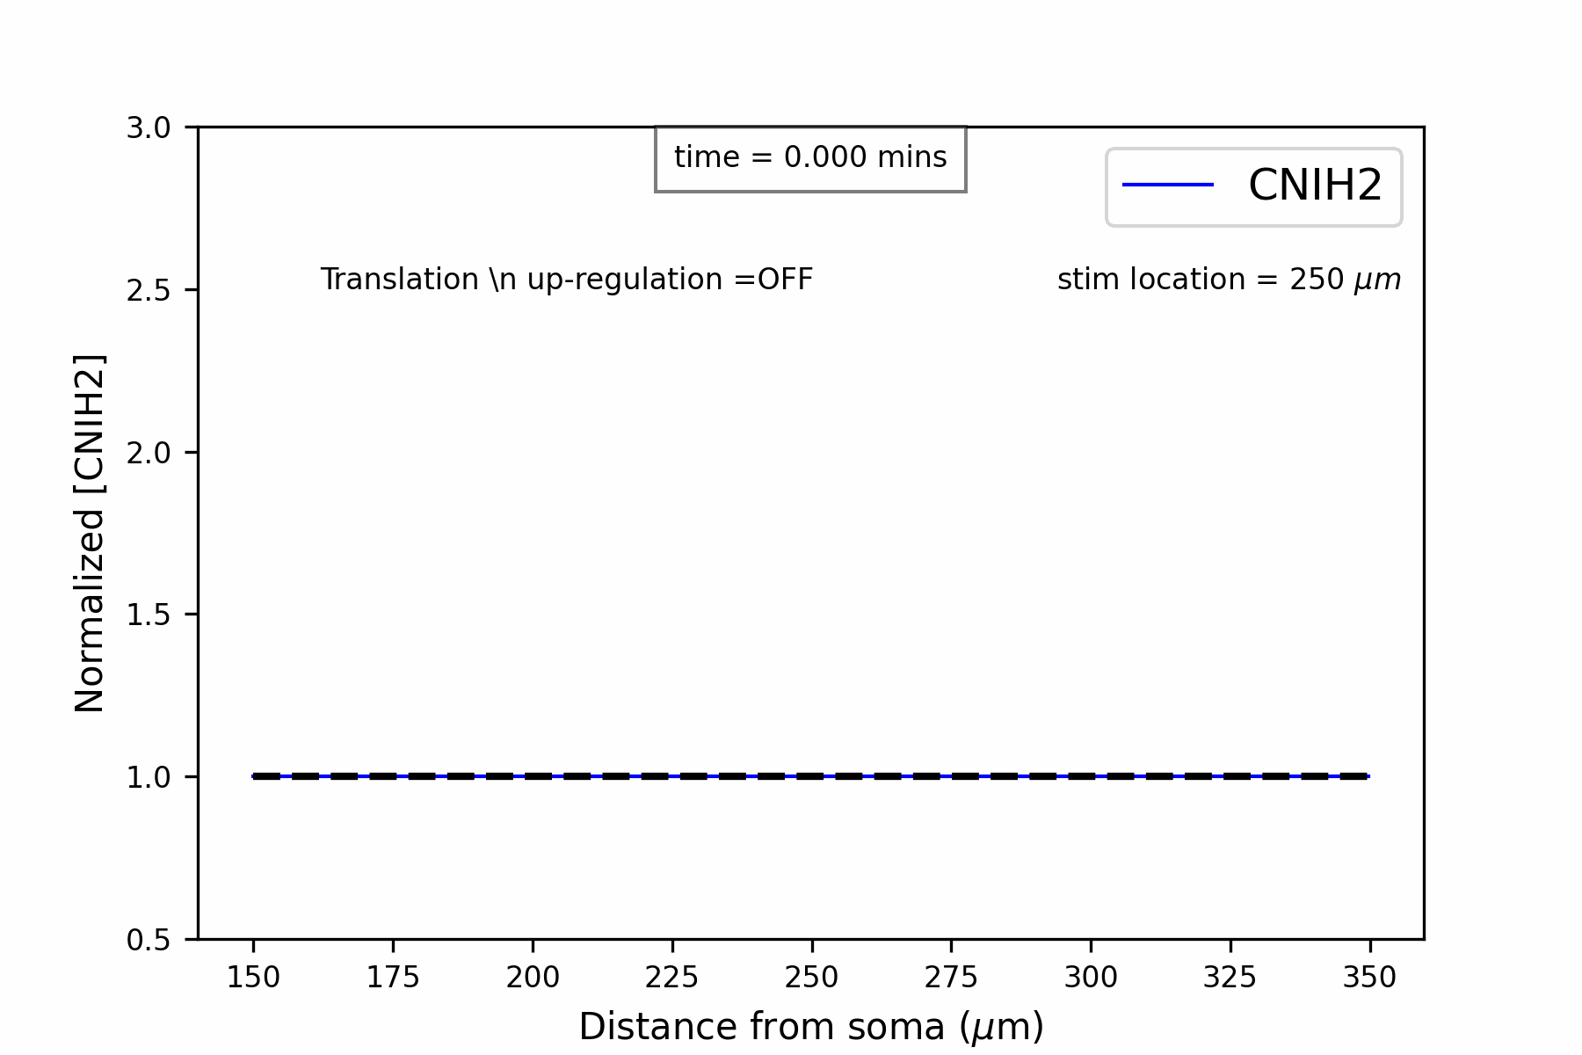
Spatiotemporal dynamics in details
Brief up-regulation
Prolonged up-regulation

